Slide 1


Slide 2
SHOPEZ:E-COMMERCE APPLICATION USING MERN
TEAM MEMBERS
HARISH.N(212621243006)
MOHAMMED RIZWAN.F(212621243018)
SANTHOSH.T(212621243027)
SURYA PRAKASH.G(212621243034)

Slide 3
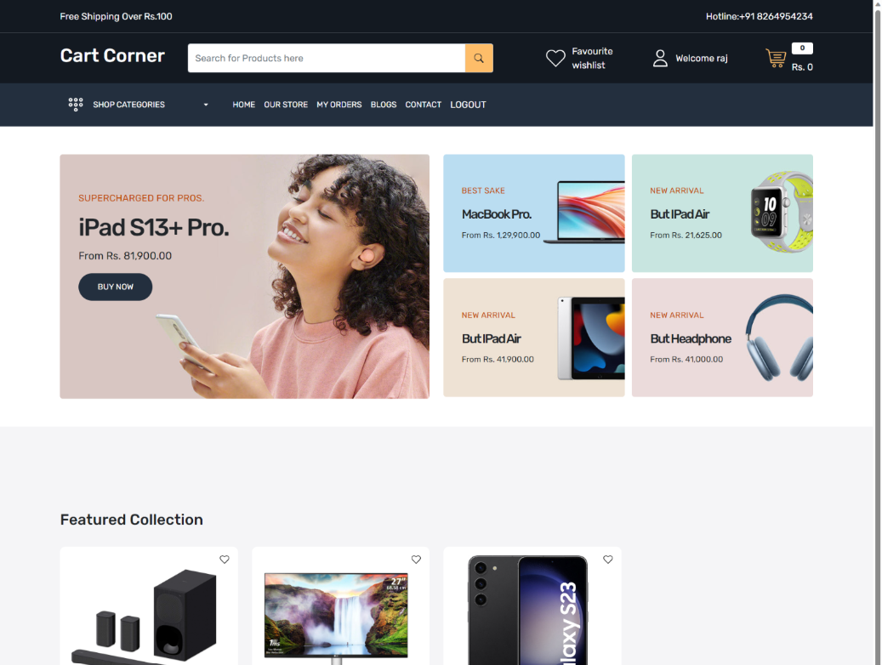
INTRODUCTION
Shopez is an e-commerce platform built using the mern stack. The platform provides a seamless online shopping experience with intuitive user interface, robust backend, and secure payment processing.

Slide 4

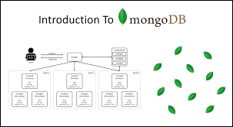
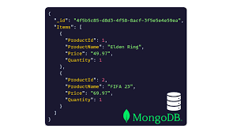
MongoDB: Data Storage
Flexible SchemaMongoDB's flexible schema allows for easy adaptation as business requirements evolve.ScalabilityMongoDB's scalability enables seamless handling of increasing data volume and user traffic.Data TypesMongoDB supports various data types, including documents, arrays, and embedded objects, to represent complex data structures.Express.js: Server-Side Development

Slide 5
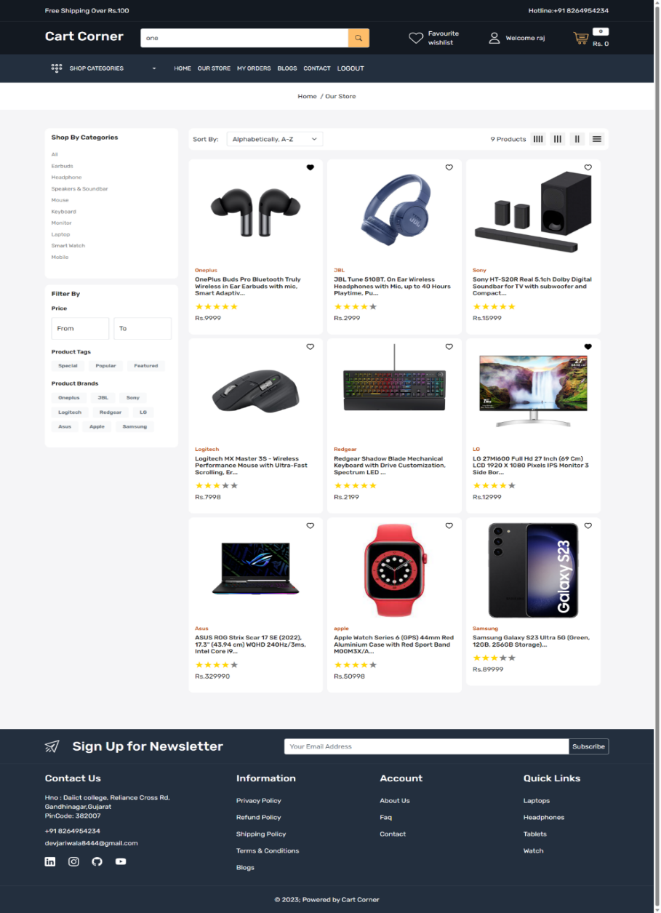
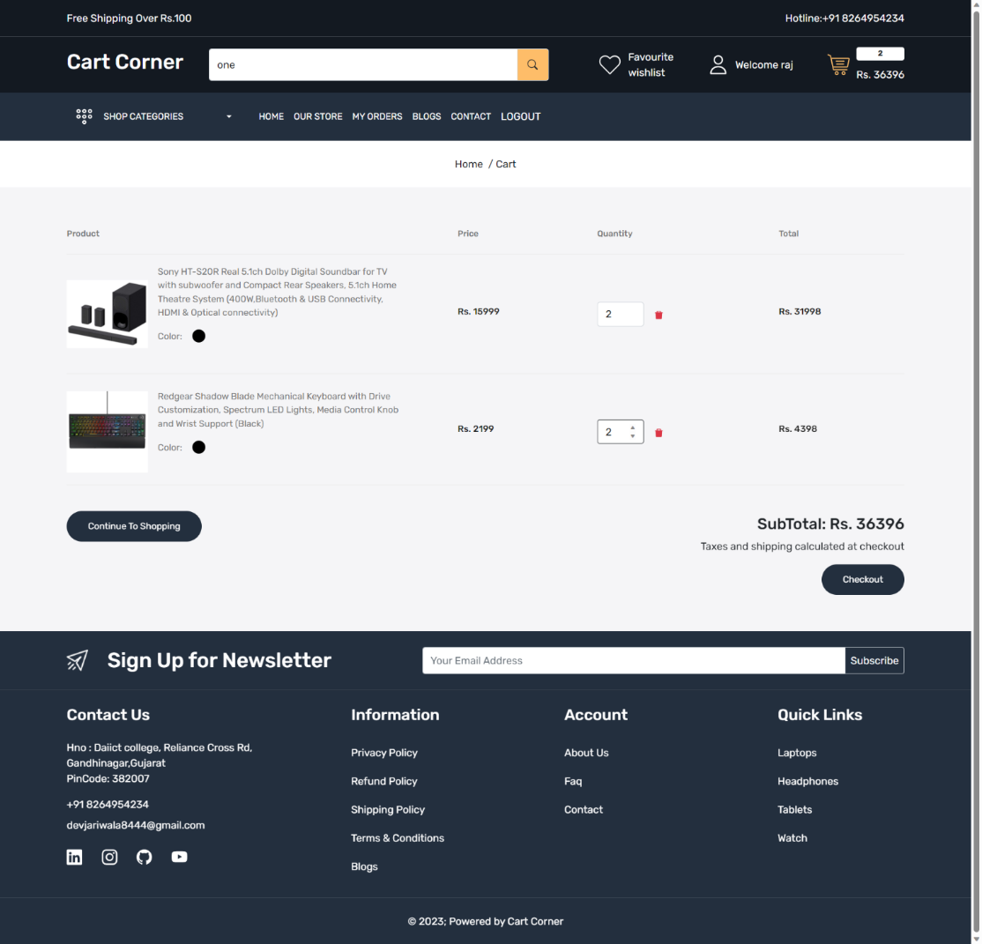
Product Catalog: Shopping Cart and Checkout:
The website should display a comprehensive catalog of products with details such as name, description, price, and images.
Products should be categorized and easily searchable to facilitate user navigation.
Users should be able to add products to their shopping cart and review cart contents before proceeding to checkout.
During the checkout process, users should provide shipping and billing information and choose a payment method.

Slide 6
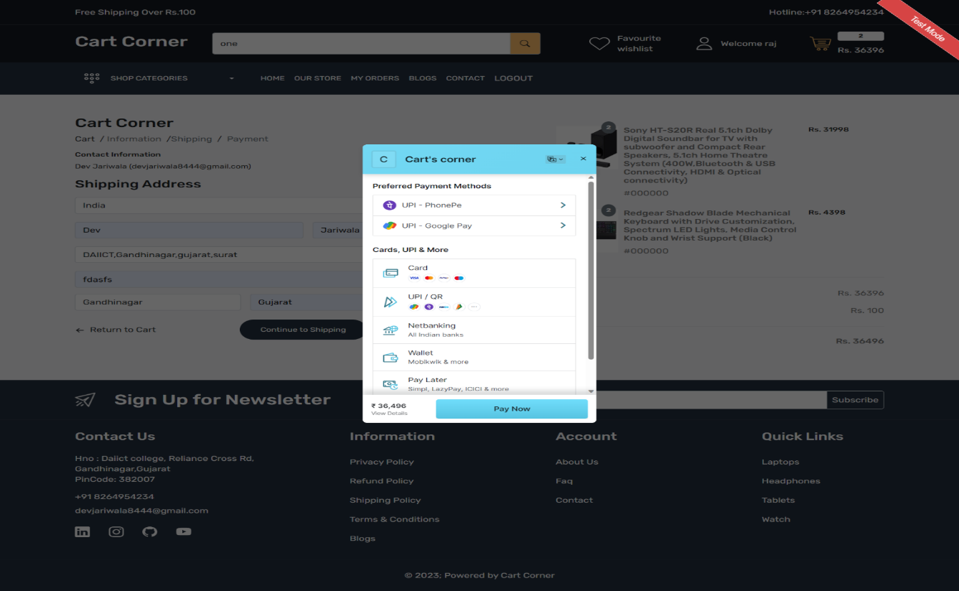
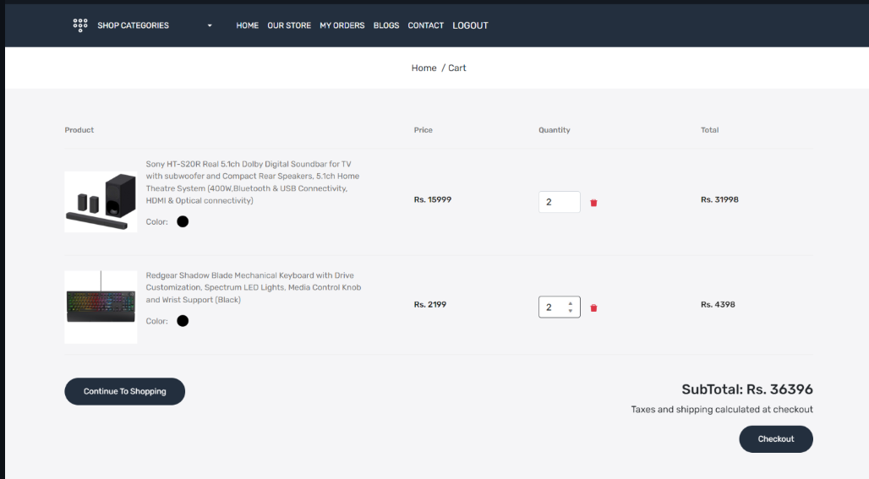
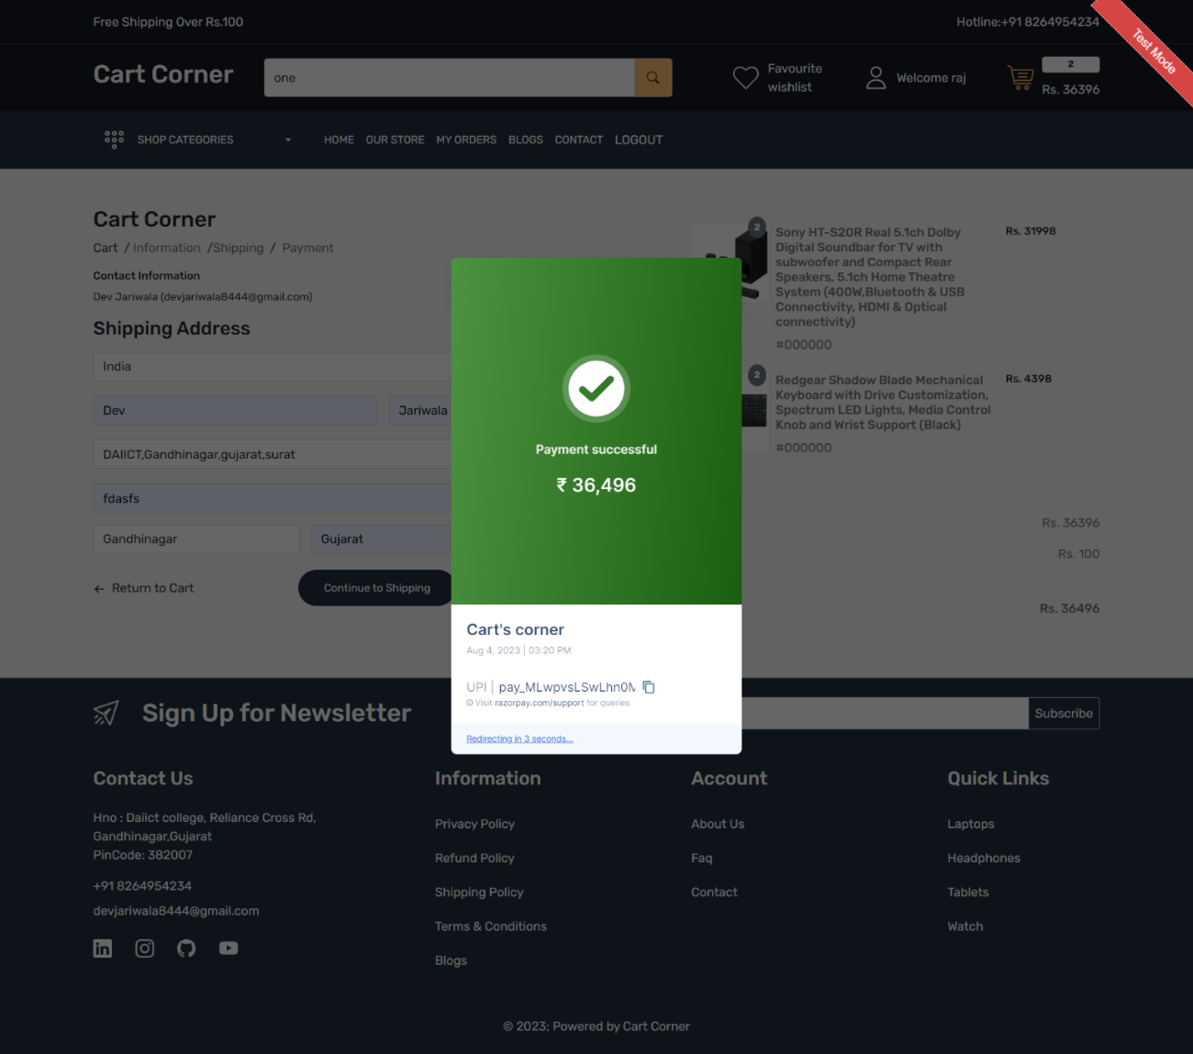
Order Management: Payment Gateway Integration:
The website should allow users to view their order history and track the status of current orders.
Admin users should have the ability to manage and process orders, update their status, and generate invoices.
. The website should integrate with a secure payment gateway to process online transactions.
. Users should have multiple payment options, such as credit/debit cards, PayPal, or other relevant payment methods.

Slide 7
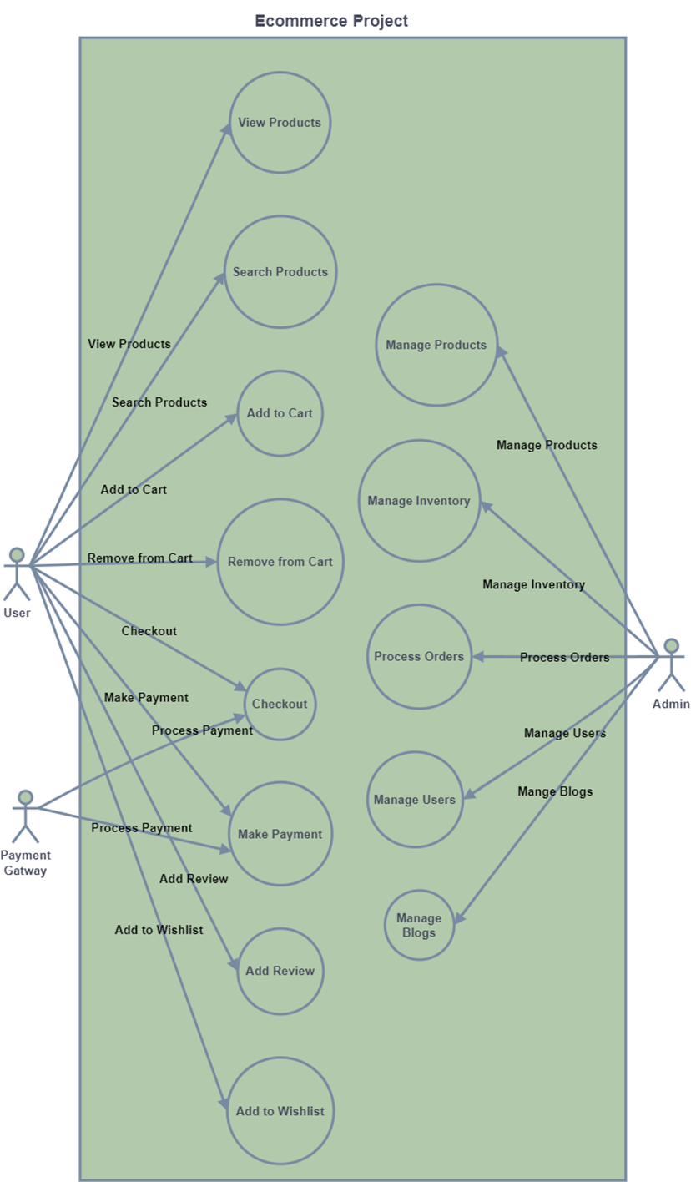
Customer Reviews and Ratings: Shopping Cart and Checkout
Users should be able to leave reviews and ratings for products they have purchased.
Average product ratings should be displayed to assist other users in making purchase decisions

Slide 8
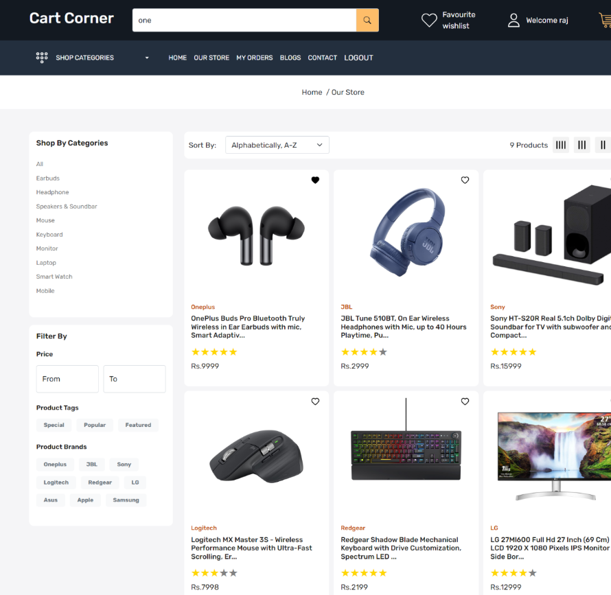
PRODUCT CATEGORIZATION
. USING CATEGORY WE CAN SORT ALL PRODUCT ALPHABETICALLY
. FOR EACH ALPHABET WE WE CAN SEARCH PRODUCT
.CATEGORY ENHANCES COST EFFECTIVENESS AND FLEXIBILITY

Slide 9
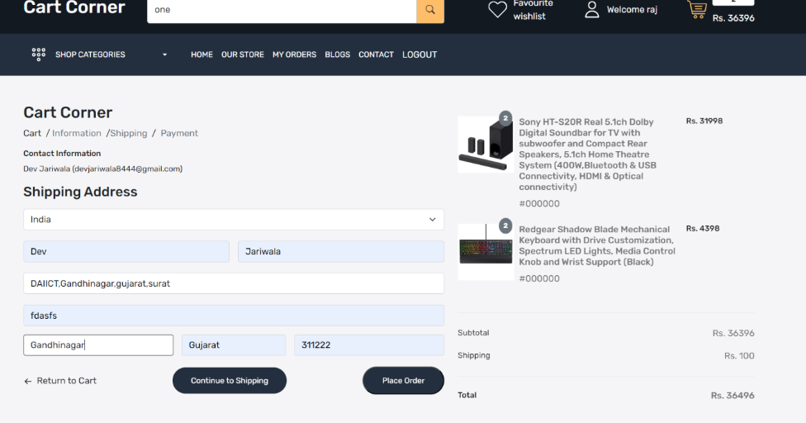
SHIPMENT ADDRESS AND ORDER PLACEMENT
.
. AFTER THE ORDER PLACEMENT NEXT STEP IS TO ENTER THE ADDRESS
. AFTER ENTERING THE ADDRESS THE NEXT STEP IS TO CONFIRM USING OTP OR EMAIL ADDRES

Slide 10
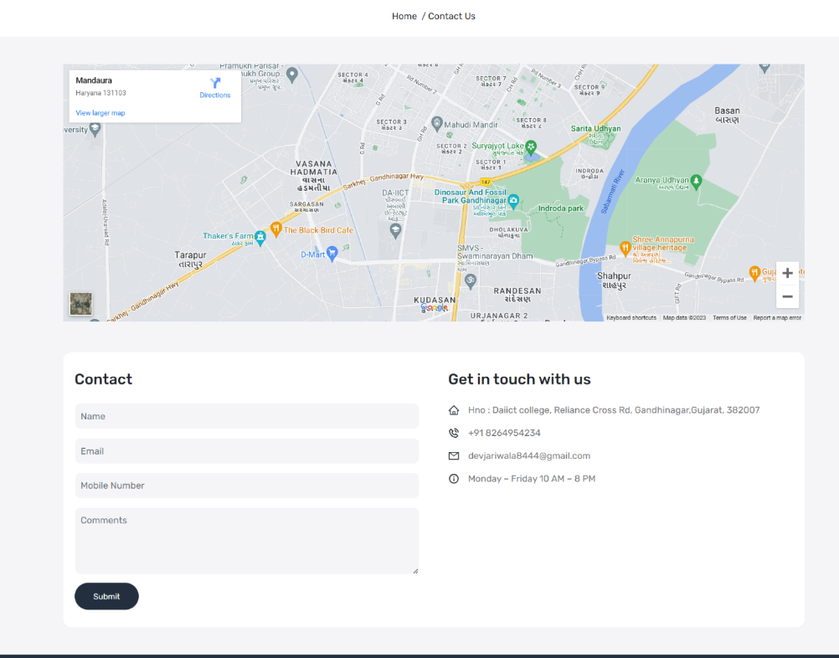
FILL FEEDBACK FORM
. AFTER WE HAVE REVIEWD THE WEBSITE NEXT STEP IS TO FILL THE FEEDBACK FORM
.THIS INCLUDE ENTERING NAME ADDRESS EMAIL ID AND PHONE NUMBER AS WELL
SUBMITTING IT

Slide 11
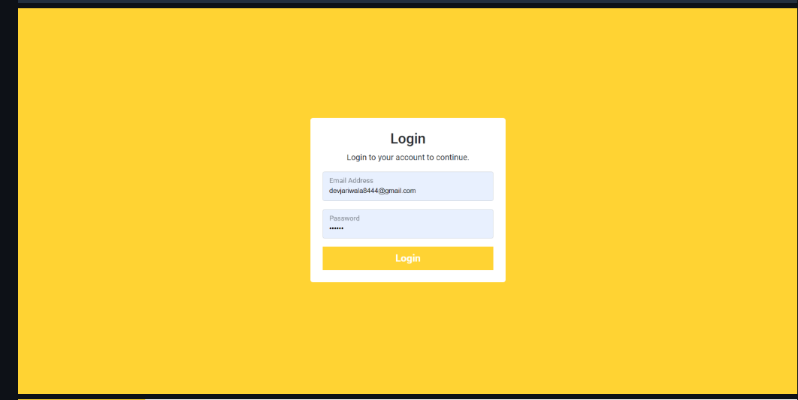
LOGIN IN PAGE
THIS IS BASIC INFO FOR ENTERING E-COMMERCE WEBSITE
FIRST IS TO ENTER FIRST NAME LASTNAME
PHONE NUMBER EMAIL ID PASSWORD AND CONFORMING THE EMAIL ID

Slide 12

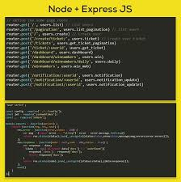
React.js: User Interface
Component-Based ArchitectureReact.js's component-based architecture enables modular development and code reusability, making the UI easy to maintain and update.Virtual DOMReact.js utilizes a virtual DOM for efficient updates, enhancing performance and user experience.JSX Syntax

Slide 13
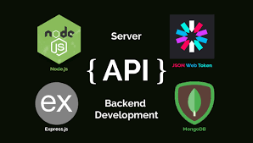
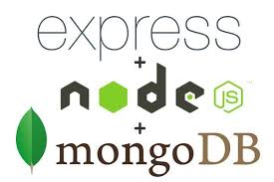
React.js:Along With MongoDb
JavaScript and XML, for writing declarative UI components.Node.js: Runtime Environment1JavaScript RuntimeNode.js allows developers to use JavaScript for both front-end and back-end utilizes JSX syntax, a combination of development, improving code consistency and developer efficiency.2Non-Blocking I/ONode.js's non-blocking I/O model enables efficient handling of concurrent operations, improving performance and scalability.3Package ManagementNode.js utilizes npm (Node Package Manager) for easily installing and managing external libraries and modules.Efficient Data ManagementNoSQLMongoDB's NoSQL capabilities offer flexibility and scalability

Slide 14

Secure User Authentication
User Registration Users can create accounts with secure passwords and email verification. 2 Login Authentication Users authenticate with their credentials, and the system verifies their identity. 3 JWT Tokens JSON Web Tokens (JWT) are used for secure authentication and authorization, providing a stateless approach

Slide 15
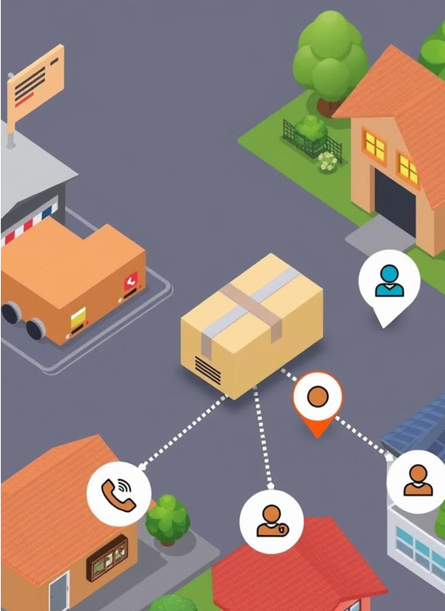
Real Time Features
order Tracking Customer Support Notifications Provides real-time updates on the status of orders, from placement to delivery. Enables instant communication with customers through live chat or messaging services. Sends timely notifications regarding order updates, promotions, and other relevant information

Slide 16
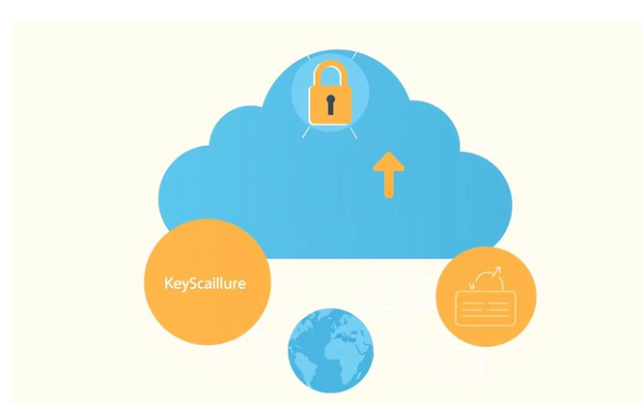

Scalable Deployment
Cloud Platform Deploying on a cloud platform provides scalability, flexibility, and cost-effectiveness.
Serverless Architecture Utilizing a serverless architecture allows for automatic scaling based on demand, minimizing resource overhead

Slide 17
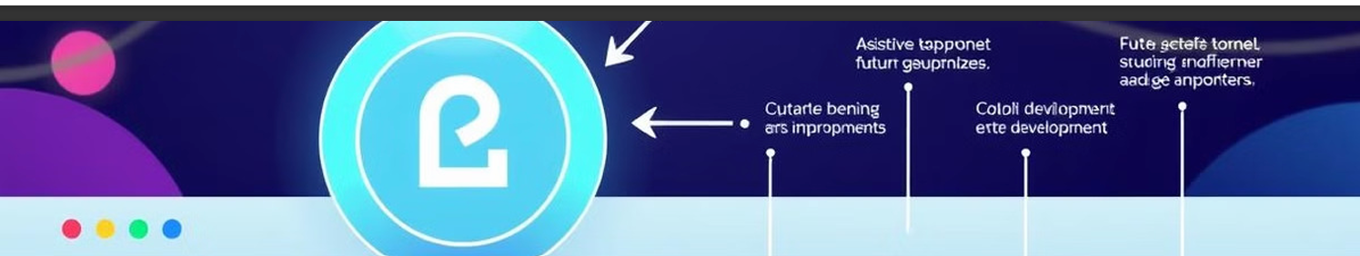
Conclusion: Future Roadmap
Enhanced Personalization Implement personalized recommendations and product suggestions based on user preferences.
Mobile App Development Develop a native mobile app for iOS and Android to enhance the shopping experience on mobile devices.
Integration with Social Media Integrate with social media platforms to enable sharing and promoting products

Slide 18
DEMO LINK FOR OUR PROJECT
https://drive.google.com/drive/folders/1-6zaKWCSqjY2Tix5kMrbdHb0bz0KBWBv

Slide 19
Thank You…

